Slide 1
Monte Carlo Simulation of Photon Migration in 3D Turbid Media using GPUs
Leiming Yu, Fanny Nina-Paravecino, David Kaeli, Qianqian Fang

Slide 2
Outline
Monte Carlo eXtreme
GPU Computing
MCX in OpenCL
Conclusion

Slide 3
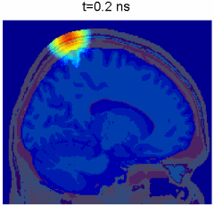
Monte Carlo eXtreme
Estimates the 3D light (fluence) distribution
by simulating a large number of
independent photons
Most accurate algorithm for a wide ranges
of optical properties, including
low-scattering/voids, high absorption and
short source-detector separation

Slide 4

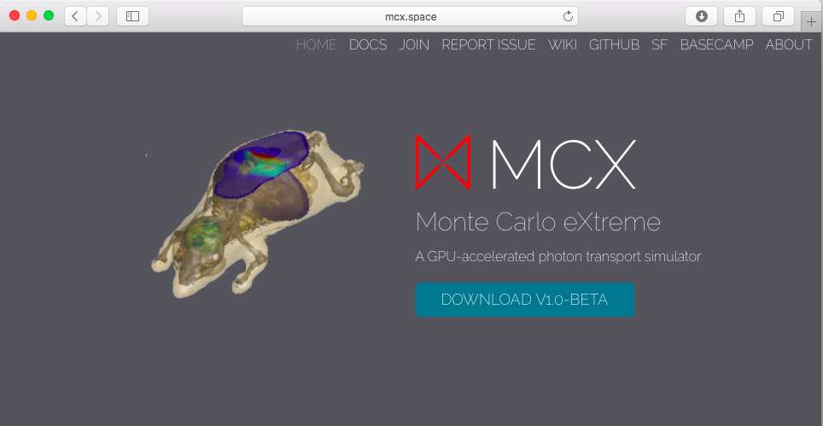
MCX.SPACE
1

Slide 5
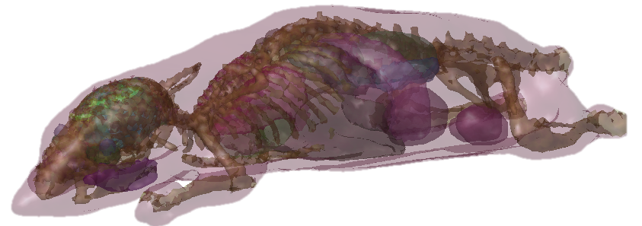
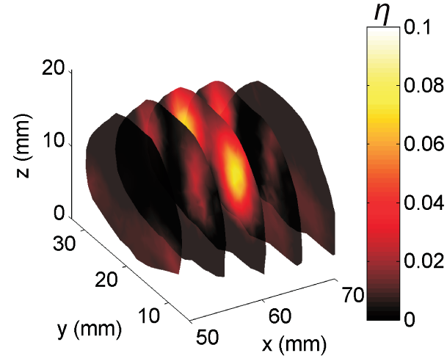
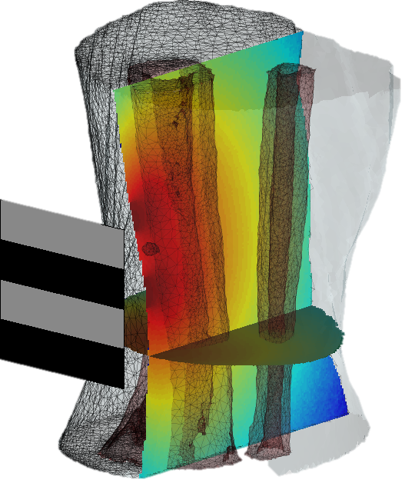
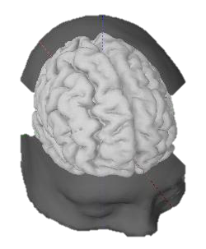
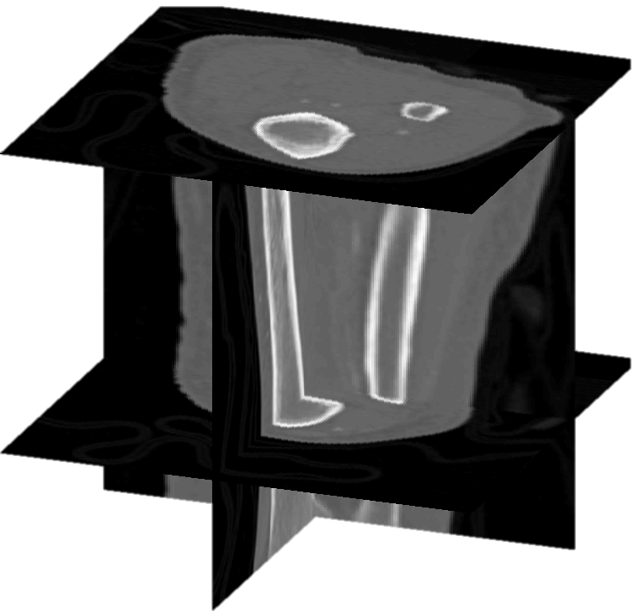
MCX Applications
Imaging of a complex mouse model using Monte Carlo simulations
Imaging of bone marrow in the tibia
Simulation of photons inside human brain

Slide 6
MCX Algorithm
Launch a new photon
Compute a new scattering length
Global Memory
Propagate photon until cross voxel boundary
Compute attenuation based on absorption
Compute a new scattering direction vector
Compute-intensive
Embarrassingly parallel
Accumulate photon energy loss to the volume
y
n
End of scattering path?
Exceeding time gate?
y
n
n
Total photon # reached?
y
Terminate thread

Slide 7
GPU Computing

Slide 8
CPU vs GPU

Slide 9
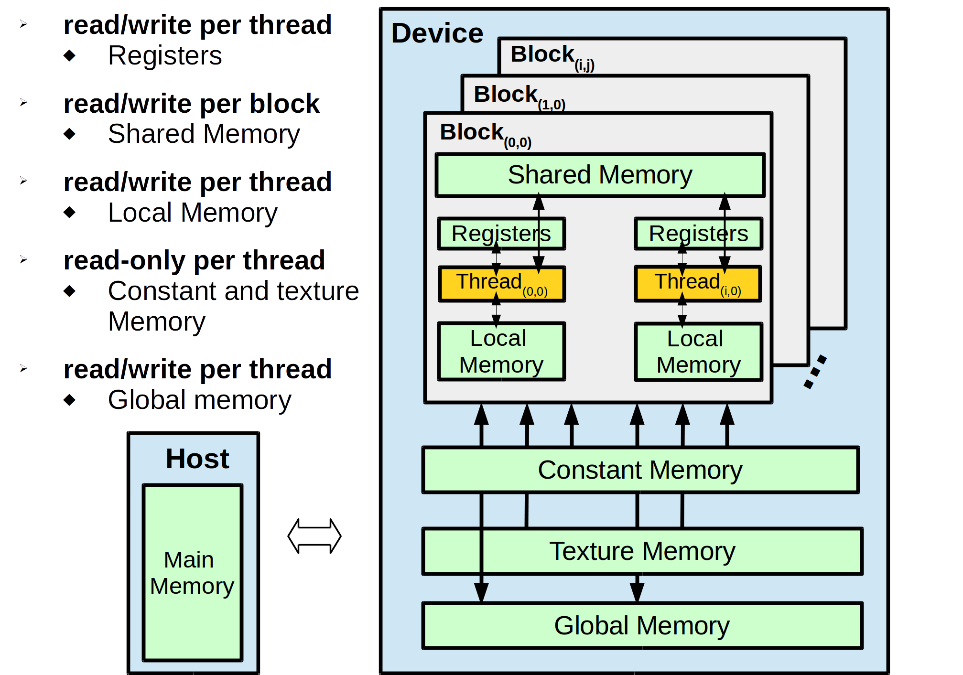
GPU Memory
Speed

Slide 10
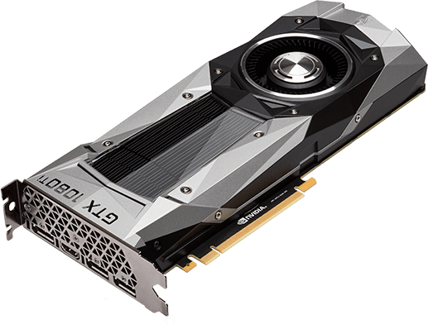
GPU Programming Languages
Compute Unified Device Architecture
(CUDA)
NVIDIA GPUs
CUDA 1.0 – 8.0 (2007 - present)
Ahead-Of-Time (offline) Compilation
Single-Instruction-Multiple-Threads (SIMT)

Slide 11

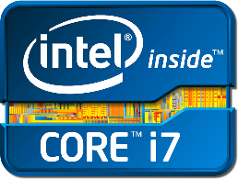

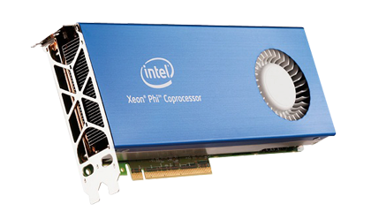
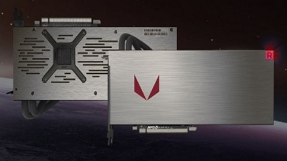
GPU Programming Languages
Open Compute Language
(OpenCL)
CPUs/GPUs/FPGAs/DSPs
OpenCL 1.0 – 2.2 (2008 - present)
  Just-In-Time (online) Compilation
Single-Instruction-Multiple-Threads (SIMT)

Slide 12
Programming Features
Supported Features | CUDA | OpenCL
Unified Memory | Yes(6.0+) | Yes(2.0+)
Dynamic Parallelism | Yes(5.0+) | Yes(2.0+)
C++ | Yes(6.0+) | Yes(2.1+)
Stream Priority | Yes(5.5+) | Yes(2.1+)
Pipes | No | Yes(2.0+)
Thread Data Sharing | Yes(5.0+) | No
Mixed-Precision | Yes(7.5+) | Yes(1.0+)

Slide 13
MCX in OpenCL

Slide 14
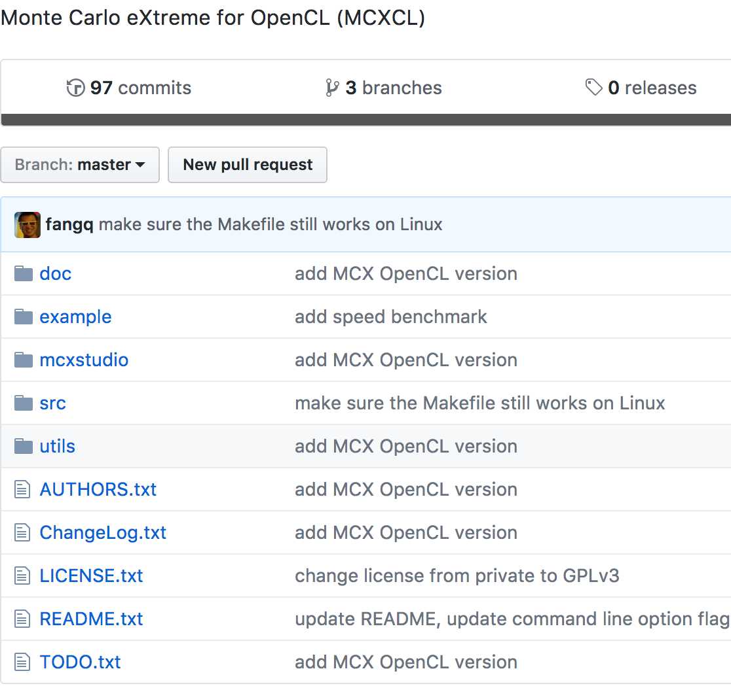

Slide 15
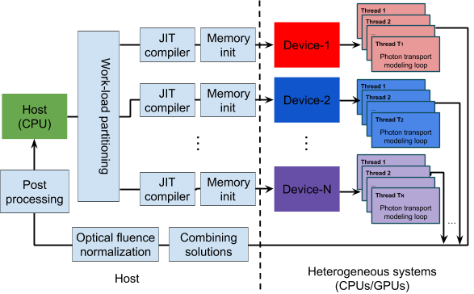
MCXCL Workflow

Slide 16
Profiling Tools
On AMD GPUs: CodeXL
On Intel CPUs : VTune

Slide 17
Optimizations : 1
Profiling on AMD R9 Nano GPU
91 million computing instructions
0.5 million memory instructions
Highly compute-intensive
“cl-mad-enable”
Use native math functions

Slide 18
Optimizations : 2
Improve Occupancy
Registers
Shared Memory
Device Limitations
Compute resource limitations
Find the “balanced” number of
threads to occupy the entire device

Slide 19
Optimizations : 3
Branches/Divergence
62% thread divergence
The parallel execution inside a wavefront can be serialized
Simplify control flow
Simplify branches

Slide 21
Static vs Dynamic
Static
allocate photons to each thread
Dynamic
allocate photon to each workgroup, each thread dynamically fetches workload

Slide 22
Load-balancing for Multiple Devices
Core-based
Throughput-based
(linear performance model)
Linear Programming (fminimax)
Ideal

Slide 23
Conclusion

Slide 24
We developed various optimization techniques to improve simulation speed, and achieved an 56% average performance improvement on AMD GPUs, 20% on Intel CPUs/GPUs and 10% on NVIDIA GPUs
We observed a significant speed gap (2.1x-5.4x) between the CUDA-based MC simulation (MCX) and MCX-CL on most NVIDIA’s GPU, reflecting of the vendor’s priority in supporting CUDA
The dynamic workgroup load-balancing strategy has resulted in an average 1% and 13% speedup for NVIDIA and AMD GPUs, respectively.
When multiple computing devices are simultaneously used for photon simulations, efficient load-partitioning strategies, based on the device throughput and linear programming models, showed improved throughput than core-based load-partitioning.

Slide 25
Acknowledgement
This project is funded by the NIH/NIGMS under the grant R01-GM114365.
We acknowledge NVIDIA for their support for this work through the NVIDIA Research Center program.

Slide 26
Questions?

Slide 27
References
[1] Q. Fang and D. A. Boas. "Monte Carlo simulation of photon migration in 3D turbid media accelerated by graphics processing units." Optics express 17.22 (2009): 20178-20190.

